Slide 1
Murach’s ASP.NET Core MVC (2nd Ed.)
Chapter 7
How to work with Razor views

Slide 2
Objectives (part 1)
Applied
Develop strongly-typed Razor views that display the elements that are unique for a web page.
Develop Razor layouts that provide the elements that are the same for multiple pages.
Knowledge
Distinguish between a Razor code block and inline expressions, loops, and if statements.
Distinguish between an inline conditional statement and an inline conditional expression.
Describe how an MVC web app typically maps its views to the action methods of its controllers.
Describe the use of tag helpers to generate a URL.
Distinguish between a relative URL and an absolute URL.

Slide 3
Objectives (part 2)
Describe how to pass a model to a view.
Distinguish between the @model directive and the @Model property.
Describe how to bind an HTML element to a property of a view’s model.
Describe how to bind a <select> element to a list of items.
Describe how to display a list of items in a <table> element.
Describe how to create and apply a layout.
Describe how to build layouts by nesting one layout within another.
Describe how a layout can use the ViewContext property to get data about the route of the current view.
Describe how to code a section in a view and render that section in a layout.

Slide 4
The syntax for a Razor code block
@{
// one or more C# statements
}
The syntax for an inline expression
@(csharp_expression)

Slide 5
The Index() action method of the Home controller
public IActionResult Index()
{
ViewBag.CustomerName = "John";
return View(); // returns Views/Home/Index.cshtml
}

Slide 6
The Views/Home/Index.cshtml file
@{
string message = "Welcome!";
if (ViewBag.CustomerName != null)
{
message = "Welcome back!";
}
}
<!DOCTYPE html>
<html>
<head>
<meta name="viewport" content="width=device-width,
initial-scale=1.0" />
<title>Home</title>
</head>
<body>
<h1>@message</h1>
<p>Customer Name: @ViewBag.CustomerName</p>
<p>2 + 2 = @(2 + 2)</p>
</body>
</html>

Slide 7
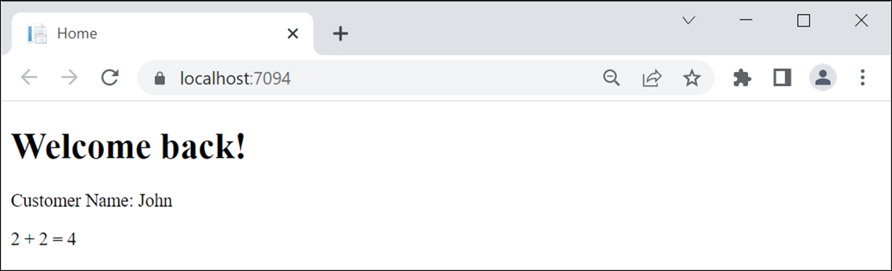
The view displayed in a browser

Slide 8
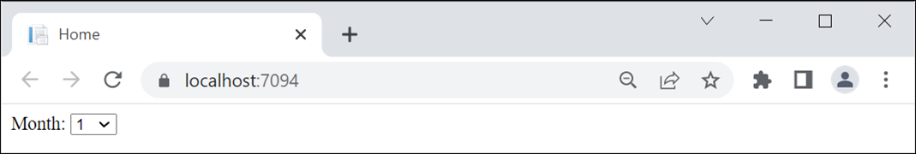
A for loop that displays a drop-down list of month numbers
<label for="month">Month:</label>
<select name="month" id="month">
@for (int month = 1; month <= 12; month++)
{
<option value="@month">@month</option>
}
</select>
The result displayed in a browser

Slide 9
Code in a controller that creates a list of strings
public IActionResult Index()
{
ViewBag.Categories = new List<string>
{
"Guitars", "Basses", "Drums"
};
return View();
}

Slide 10
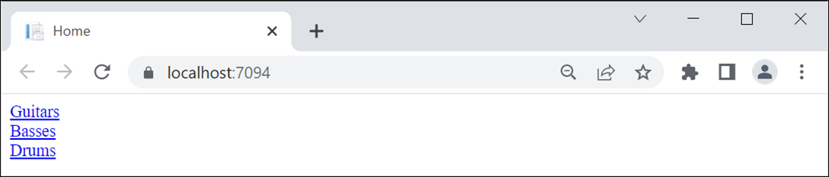
A foreach loop that displays a list of links
@foreach (string category in ViewBag.Categories)
{
<div>
<a href="/Product/List/@category/">@category</a>
</div>
}
The result displayed in a browser

Slide 11
An if-else statement in a view
@if (ViewBag.ProductID == 1)
{
<p>Fender Stratocaster</p>
}
else if (ViewBag.ProductID == 2)
{
<p>Gibson Les Paul</p>
}
else
{
<p>Product Not Found</p>
}

Slide 12
A switch statement in a view
@switch (ViewBag.ProductID)
{
case 1:
<p>Fender Stratocaster</p>
break;
case 2:
<p>Gibson Les Paul</p>
break;
default:
<p>Product Not Found</p>
break;
}

Slide 13
An if statement that adds a Bootstrap CSS class if true
<a asp-controller="Product" asp-action="List"
asp-route-id="All"
class="list-group-item
@if (ViewBag.SelectedCategoryName == "All") {
<text>active</text>
}">
All
</a>

Slide 14
A conditional expression that adds a Bootstrap CSS class if true
<a asp-controller="Product" asp-action="List" asp-route-id="All"
class="list-group-item
@(ViewBag.SelectedCategoryName == "All" ? "active" : "")">
All
</a>

Slide 15
The starting folders and files for the Guitar Shop app
GuitarShop
/Controllers
/HomeController.cs
/ProductController.cs
/Models
/Category.cs
/Product.cs
/Shopcontext.cs
/Views
/Home
/Index.cshtml -- the view for the Home/Index action
/About.cshtml -- the view for the Home/About action
/Product
/List.cshtml -- the view for the Product/List action
/Details.cshtml -- the view for the Product/Details action
/Update.cshtml -- the view for the Product/Update action
/Shared
/_Layout.cshtml -- a layout that can be shared by views
_ViewImports.cshtml -- imports models and tag helpers for views
_ViewStart.cshtml -- specifies the default layout for views
/wwwroot
/css
/site.css
/lib
/bootstrap/dist/css/bootstrap.min.css
Program.cs -- configures middleware that may impact views

Slide 16
The routing that’s specified in the Program.cs file
app.UseRouting();
...
app.MapControllerRoute(
name: "default",
pattern: "{controller=Home}/{action=Index}/{id?}");

Slide 17
A method that a controller can use to return a view result to the browser
View()
View(name)

Slide 18
The Home controller
public class HomeController : Controller
{
public IActionResult Index()
{
return View(); // Views/Home/Index.cshtml
}
}

Slide 19
The Product controller
public class ProductController : Controller
{
public IActionResult Index()
{
return View("List"); // Views/Product/List.cshtml
}
public IActionResult List(string id = "All")
{
ViewBag.Category = id;
return View(); // Views/Product/List.cshtml
}
public IActionResult Details(string id)
{
ViewBag.ProductSlug = id;
return View(); // Views/Product/Details.cshtml
}
}

Slide 20
The _Layout.cshtml file in the Views/Shared folder
<!DOCTYPE html>
<html>
<head>
<title>@ViewBag.Title</title>
<link rel="stylesheet"
href="~/lib/bootstrap/dist/css/
bootstrap.min.css" />
<link rel="stylesheet" href="~/css/site.css" />
</head>
<body class="container-fluid">
@RenderBody()
</body>
</html>

Slide 21
A _ViewStart.cshtml file that sets the default layout
@{
Layout = "_Layout";
}
A _ViewImports.cshtml file that enables all ASP.NET Core tag helpers
@addTagHelper *, Microsoft.AspNetCore.Mvc.TagHelpers

Slide 22
How to add a Razor layout, view start, or view imports file
Right-click on the folder where you want to add the file and select the Add→New Item item.
In the resulting dialog, select the ASP.NET Core→Web category.
Select the Razor item you want to add and respond to the resulting dialog boxes.

Slide 23
Three tag helpers for generating URLs
asp-controller
asp-action
asp-route-param_name

Slide 24
Two ways to code a link
Use HTML to hardcode the URL in the href attribute
<a href="/Product/List/Guitars">View guitars</a>
Use ASP.NET tag helpers to generate the URL
<a asp-controller="Product" asp-action="List"
asp-route-id="Guitars">View guitars</a>
The URL for both links
/Product/List/Guitars

Slide 25
How to code a link to an action method in the same controller
<a asp-action="About">About Us</a>
The URL that’s generated
/Home/About
How to code a link to an action method in a different controller
<a asp-controller="Product" asp-action="List">View all products</a>
The URL that’s generated
/Product/List

Slide 26
How to code a link that includes a parameter that’s in a route
<a asp-controller="Product" asp-action="List"
asp-route-id="Guitars">View guitars</a>
The URL that’s generated
/Product/List/Guitars
A link that specifies route parameters that don’t exist
<a asp-controller="Product" asp-action="List"
asp-route-page="1" asp-route-sort_by="price">Products - Page 1</a>
The URL that’s generated
/Product/List?page=1&sort_by=price

Slide 27
The Home/Index view
@{
ViewData["Title"] = "Home";
}
<h1>Home</h1>
<div class="list-group">
<a asp-controller="Product" asp-action="List">
View all products</a>
<a asp-controller="Product" asp-action="List"
asp-route-id="Guitars">View guitars</a>
<a asp-controller="Product" asp-action="Details"
asp-route-id="Fender-Stratocaster">
View Fender Stratocaster</a>
</div>

Slide 28
The Product/List view
@{
ViewData["Title"] = "Product List";
}
<h1>Product List</h1>
<div class="list-group">
<p>Category: @ViewBag.Category</p>
<a asp-action="Details"
asp-route-id="Fender-Stratocaster">
View Fender Stratocaster</a>
<a asp-controller="Home" asp-action="Index">Home</a>
</div>

Slide 29
The Product/Details view
@{
ViewData["Title"] = "Product Details";
}
<h1>Product Details</h1>
<div class="list-group">
<p>Slug: @ViewBag.ProductSlug</p>
<a asp-controller="Home" asp-action="Index">Home</a>
</div>

Slide 30
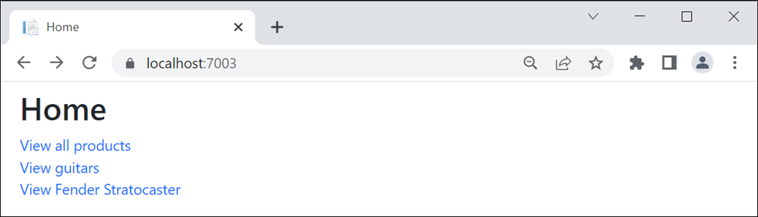
A browser displaying the Home page

Slide 31
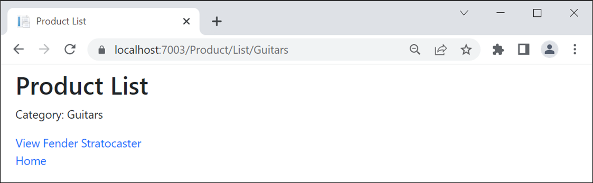
A browser after clicking the View Guitars link

Slide 32
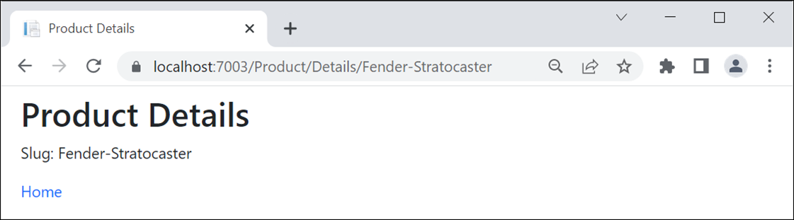
A browser after clicking the View Fender Stratocaster link

Slide 33
More tag helpers for generating URLs
asp-area
asp-fragment
asp-protocol
asp-host

Slide 34
How to code a link to an area
<a asp-area="Admin" asp-controller="Product"
asp-action="List">Admin - Product Manager</a>
The URL that’s generated
/Admin/Product/List

Slide 35
How to code an HTML placeholder
<h2 id="Fender">Fender Guitars</h2>
How to code a URL that jumps to an HTML placeholder on the same page
<a asp-fragment="Fender">View Fender Guitars</a>
The URL that’s generated
/#Fender

Slide 36
How to code an absolute URL
<a asp-protocol="https"
asp-host="murach.com"
asp-controller="Shop"
asp-action="Details"
asp-route-id="html-and-css"
asp-fragment="reviews">Murach's HTML and CSS - Reviews</a>
The URL that’s generated
https://www.murach.com/Shop/Details/html-and-css#reviews

Slide 37
Format specifiers you can use to format numbers
Specifier | Name
C | Currency
N | Number
P | Percent

Slide 38
Code that stores numbers in the ViewBag
ViewBag.Price = 12345.67;
ViewBag.DiscountPercent = .045;
ViewBag.Quantity = 1234;

Slide 39
Razor expressions that format the numbers
Expression | Result
@ViewBag.Price.ToString("C") | $12,345.67
@ViewBag.Price.ToString("C1") | $12,345.7
@ViewBag.Price.ToString("C0") | $12,346
@ViewBag.Price.ToString("N") | 12,345.67
@ViewBag.Price.ToString("N1") | 12,345.7
@ViewBag.Price.ToString("N0") | 12,346
@ViewBag.DiscountPercent.ToString("P") | 4.50%
@ViewBag.DiscountPercent.ToString("P1") | 4.5%
@ViewBag.DiscountPercent.ToString("P0") | 5%

Slide 40
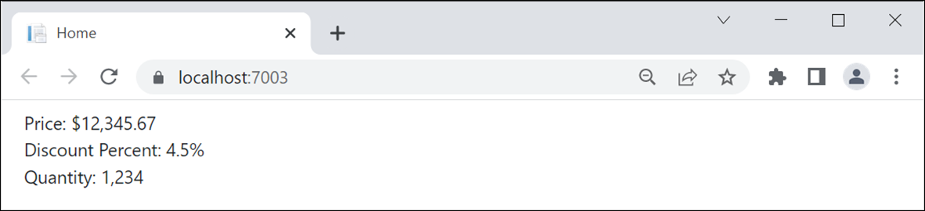
Code in a view that displays the numbers
<div>Price: @ViewBag.Price.ToString("C")</div>
<div>Discount Percent: @ViewBag.DiscountPercent.ToString("P1")</div>
<div>Quantity: @ViewBag.Quantity.ToString("N0")</div>
The view displayed in a browser

Slide 41
The Product model
namespace GuitarShop.Models
{
public class Product
{
public int ProductID { get; set; }
public int CategoryID { get; set; }
public string Code { get; set; } = string.Empty;
public string Name { get; set; } = string.Empty;
public decimal Price { get; set; }
public string Slug => Name.Replace(' ', '-');
public Category Category { get; set; } = null!;
}
}

Slide 42
The Category model
namespace GuitarShop.Models
{
public class Category
{
public int CategoryID { get; set; }
public string Name { get; set; } = string.Empty;
}
}

Slide 43
A method that a controller can use to pass a model to a view
View(model)
View(name, model)

Slide 44
The Product/Details() action method that passes a model to a view
public IActionResult Details(int id)
{
Product product =
context.Products.Where(p => p.ProductID == id)
.Include(p => p.Category)
.FirstOrDefault() ?? new Product();
return View(product);
}
A Product/Add() action method that passes a model to the specified view
[HttpGet]
public IActionResult Add()
{
return View("Update", new Product());
}

Slide 45
A directive for displaying model properties in a view
@model
A property for displaying model properties in a view
@Model

Slide 46
A _ViewImports file that imports the Models namespace for all views
@addTagHelper *, Microsoft.AspNetCore.Mvc.TagHelpers
@using GuitarShop.Models
The code for the Product/Details view
@model Product
@{
ViewData["Title"] = "Product Details";
}
<h1>Product Details</h1>
<div>ID: @Model.ProductID</div>
<div>Name: @Model.Name</div>
<div>Category: @Model.Category.Name</div>
<div>Price: @Model.Price.ToString("C2")</div>
<a asp-controller="Home" asp-action="Index">Home</a>

Slide 47
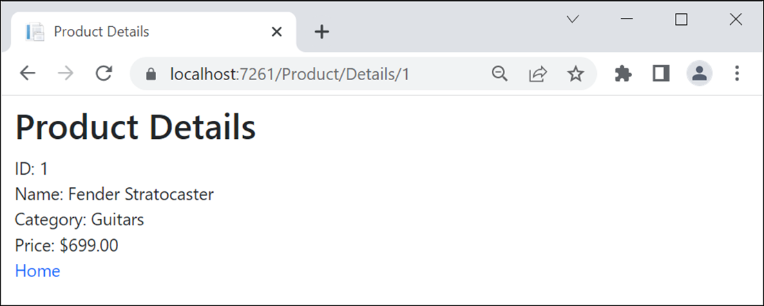
The view with model properties in a browser

Slide 48
A tag helper for binding HTML elements to model properties
asp-for
A view with asp-for tag helpers (part 1)
@model Product
@{
ViewData["Title"] = "Update Product";
}
<h1>Update Product</h1>
<form asp-action="Update" method="post">
<div class="mb-3">
<label asp-for="Name" class="form-label"></label>
<input asp-for="Name" class="form-control">
</div>
<div class="mb-3">
<label asp-for="Price" class="form-label">
</label>
<input asp-for="Price" class="form-control">
</div>

Slide 49
A view with asp-for tag helpers (part 2)
<input type="hidden" asp-for="ProductID" />
<input type="hidden" asp-for="Category.Name" />
<button type="submit" class="btn btn-primary">
Update</button>
<a asp-action="List" class="btn btn-primary">
Cancel</a>
</form>

Slide 50
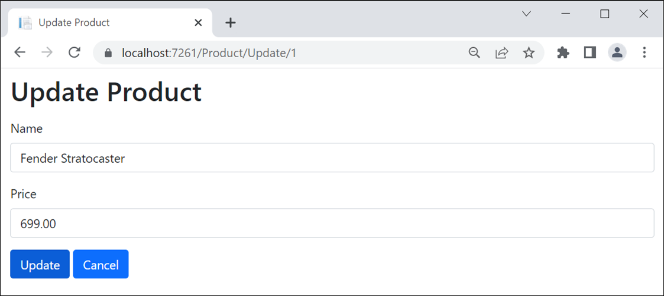
The view with bound properties in a browser

Slide 51
The HTML that’s generated for the Price <label> and <input> elements
<label class="form-label" for="Price">Price</label>
<input class="form-control" type="text"
id="Price" name="Price" value="699.00">

Slide 52
A tag helper for adding options to a <select> element
asp-items
The constructor of the SelectList class
SelectList(list, value, text, selectedValue)

Slide 53
An action method that gets model data and passes it to the view
public IActionResult Update(int id)
{
ViewBag.Categories = context.Categories.ToList();
Product product = context.Products.Find(id) ?? new Product();
return View(product);
}

Slide 54
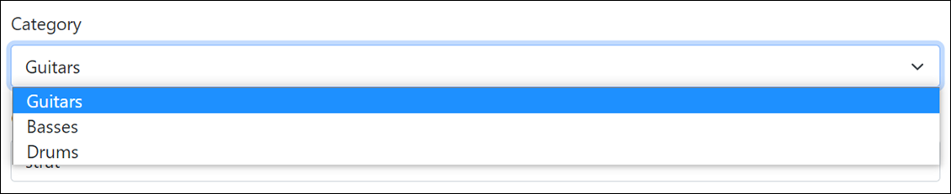
The code that binds items to a <select> element
<div class="mb-3">
<label asp-for="CategoryID" class="form-label">
Category</label>
<select asp-for="CategoryID"
asp-items="@(new SelectList(ViewBag.Categories,
"CategoryID", "Name"))"
class="form-select"></select>
</div>
The <select> element and its label displayed in a browser

Slide 55
HTML that’s generated for the <select> element
<select class="form-select" id="CategoryID"
name="CategoryID">
<option selected="selected" value="1">
Guitars</option>
<option value="2">Basses</option>
<option value="3">Drums</option>
</select>

Slide 56
An action method that creates the model and passes it to the view
public IActionResult List(string id = "All")
{
ViewBag.Categories = context.Categories.ToList();
ViewBag.SelectedCategory = id;
// initialize the model
List<Product> products = null!;
// populate the model based on id value
if (id == "All")
{
products = context.Products.ToList();
}
else
{
products = context.Products
.Where(p => p.Category.Name == id).ToList();
}
// pass the model to the view
return View(products);
}

Slide 57
The code for the view (part 1)
@model List<Product>
@{
ViewData["Title"] = "Product List";
}
<h1>Product List</h1>
@if (ViewBag.Categories != null)
{
foreach (Category c in ViewBag.Categories)
{
<a asp-controller="Product" asp-action="List"
asp-route-id="@c.Name">@c.Name</a><text> | </text>
}
}
<a asp-controller="Product" asp-action="List"
asp-route-id="All">All</a>
<hr />

Slide 58
The code for the view (part 2)
@if (@ViewBag.SelectedCategory == "All")
{
<h2>All Products</h2>
}
else
{
<h2>@ViewBag.SelectedCategory</h2>
}
<table class="table table-bordered table-striped">
<thead>
<tr>
<th>Name</th>
<th>Price</th>
<th></th>
<th></th>
</tr>
</thead>

Slide 59
The code for the view (part 3)
<tbody>
@foreach (var product in @Model)
{
<tr>
<td>@product.Name</td>
<td>@product.Price.ToString("C")</td>
<td>
<a asp-controller="Product"
asp-action="Details"
asp-route-id="@product.ProductID">View</a>
</td>
<td>
<a asp-controller="Product"
asp-action="Update"
asp-route-id="@product.ProductID">
Update</a>
</td>
</tr>
}
</tbody>
</table>

Slide 60
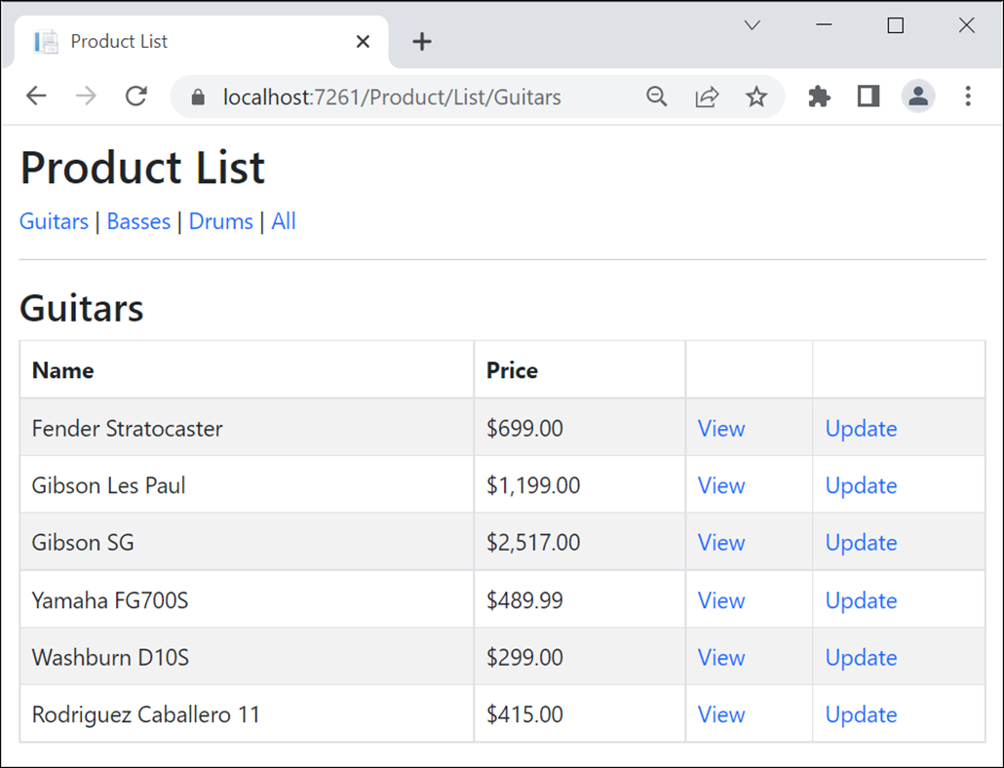
The Product objects view in a browser

Slide 61
The Views/Shared/_MainLayout.cshtml file (part 1)
<!DOCTYPE html>
<html>
<head>
<title>@ViewBag.Title</title>
<link rel="stylesheet"
href="~/lib/bootstrap/dist/css/bootstrap.min.css" />
<link rel="stylesheet" href="~/css/site.css" />
</head>
<body class="container-fluid">
<header>
<a asp-controller="Home" asp-action="Index">
Home</a> |
<a asp-controller="Product" asp-action="List">
Products</a> |
<a asp-controller="Home" asp-action="About">
About</a>
<hr />
</header>

Slide 62
The Views/Shared/_MainLayout.cshtml file (part 2)
<main>
@RenderBody()
</main>
<footer>
<hr />
<p>&copy; @DateTime.Now.Year - Guitar Shop</p>
</footer>
</body>
</html>

Slide 63
The code for a _ViewStart.cshtml file that sets the default layout
@{
Layout = "_Layout";
}
The code for a Home/Index view that explicitly specifies a layout
@{
Layout = "_MainLayout";
ViewBag.Title = "Home";
}
<p>Welcome to the Guitar Shop!</p>

Slide 64
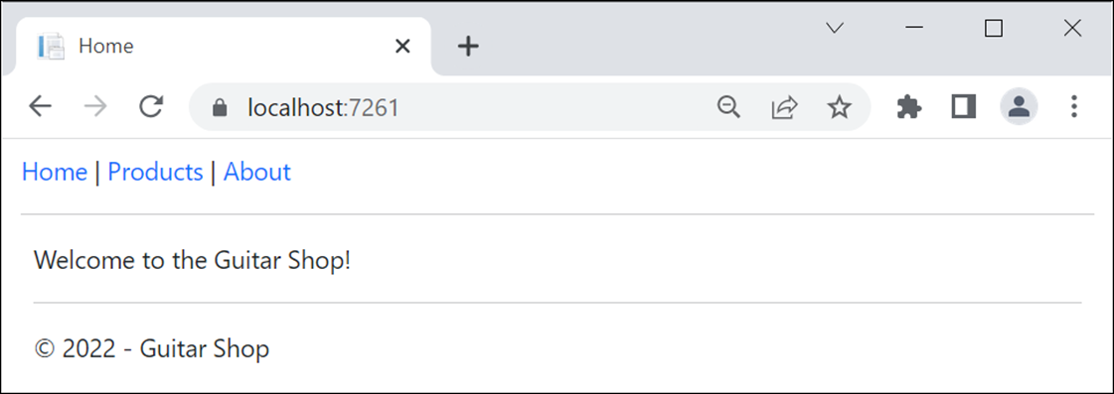
The Home page

Slide 65
The _Layout file
<!DOCTYPE html>
<html>
<head>
<title>@ViewBag.Title</title>
<link rel="stylesheet"
href="~/lib/bootstrap/dist/css/bootstrap.min.css" />
<link rel="stylesheet" href="~/css/site.css" />
</head>
<body class="container-fluid">
@RenderBody()
</body>
</html>

Slide 66
The _MainLayout file
@{
Layout = "_Layout";
}
<header>
<a asp-controller="Home" asp-action="Index">Home</a> |
<a asp-controller="Product" asp-action="List"
asp-route-id="All">Products</a> |
<a asp-controller="Home" asp-action="About">About</a>
<hr />
</header>
<main>
@RenderBody()
</main>
<footer>
<hr />
<p>&copy; @DateTime.Now.Year - Guitar Shop</p>
</footer>

Slide 67
The _ProductLayout file
@{
Layout = "_MainLayout";
}
<h1>Product List</h1>
@if (ViewBag.Categories != null)
{
foreach (Category c in ViewBag.Categories)
{
<a asp-controller="Product" asp-action="List"
asp-route-id="@c.Name">@c.Name</a>
<text> | </text>
}
<a asp-controller="Product" asp-action="List"
asp-route-id="All">All</a>
}
<hr />
@RenderBody()

Slide 68
The code for a view that uses the _ProductLayout view
@model List<Product>
@{
Layout = "_ProductLayout";
ViewBag.Title = "Product List";
}
@if (@ViewBag.SelectedCategory == "All")
{
<h2>All Products</h2>
}
else
{
<h2>@ViewBag.SelectedCategory</h2>
}
<!-- The rest of the code is the same as the <table>
element in part 2 of figure 7-16 -->

Slide 69
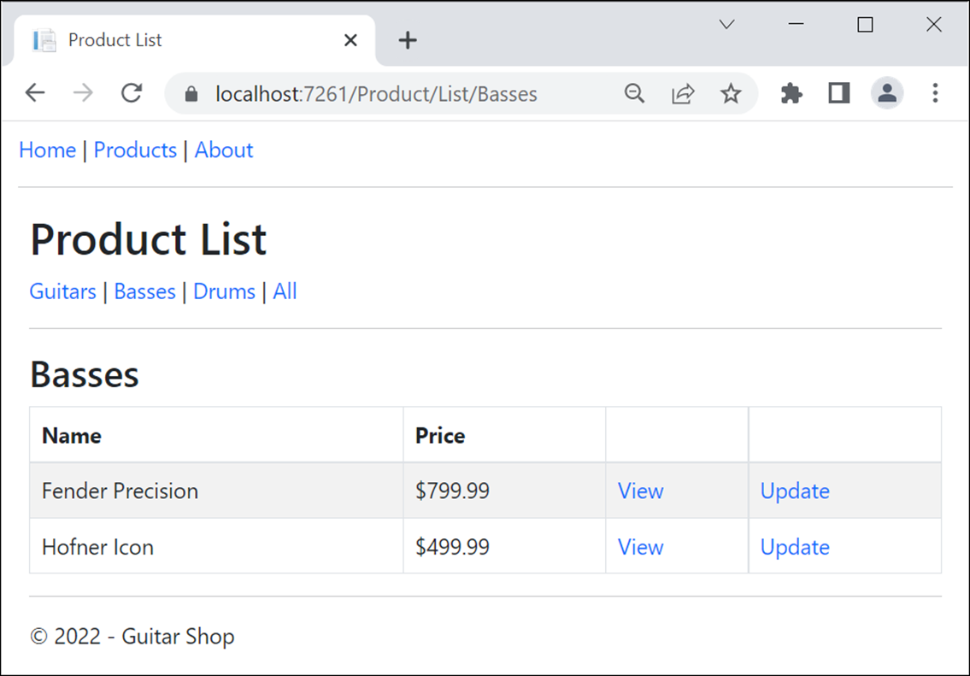
The view with nested layouts in a browser

Slide 70
A _MainLayout file that uses view context (part 1)
@{
Layout = "_Layout";
string c =
ViewContext.RouteData.Values["controller"]?.ToString()
?? "";
string a =
ViewContext.RouteData.Values["action"]?.ToString() ?? "";
}
<header>
<nav class="navbar navbar-expand-md navbar-dark bg-primary
fixed-top">
<div class="container-fluid">
<a class="navbar-brand" href="/">My Guitar Shop</a>
<!-- toggle button same as figure 3-20 -->
<nav class="collapse navbar-collapse"
id="navbarSupportedContent">
<div class="navbar-nav me-auto">
<a class="nav-item nav-link
@(c == "Home" && a == "Index" ?
"active" : "")"
asp-controller="Home" asp-action="Index">
Home</a>

Slide 71
A _MainLayout file that uses view context (part 2)
<a class="nav-item nav-link
@(c == "Product" ? "active" : "")"
asp-controller="Product" asp-action="List">
Products</a>
<a class="nav-item nav-link
@(c == "Home" && a == "About" ?
"active" : "")"
asp-controller="Home" asp-action="About">
About</a>
</div>
</nav>
</div>
</nav>
</header>
<main>
@RenderBody()
</main>
<footer>
<hr />
<p>&copy; @DateTime.Now.Year - Guitar Shop</p>
</footer>

Slide 72
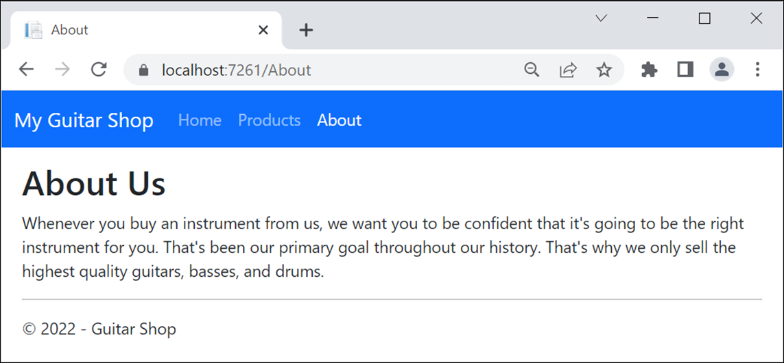
A view that uses this layout

Slide 73
A method that can insert content from a section into a layout
RenderSection(name, required)
A layout file that inserts the content from an optional section named scripts
<!DOCTYPE html>
<html>
<head>
<title>@ViewBag.Title</title>
<link rel="stylesheet"
href="~/lib/bootstrap/css/bootstrap.min.css" />
<link rel="stylesheet" href="~/css/site.css" />
</head>
<body class="container-fluid">
@RenderBody()
<script src="~/lib/popper.js/popper.min.js"></script>
<script src="~/lib/bootstrap/js/bootstrap.min.js"></script>
<script src="~/lib/jquery/jquery.min.js"></script>
@RenderSection("scripts", required:false)
</body>
</html>

Slide 74
A view file with a section named scripts
@model Product
@{
ViewData["Title"] = "Update Product";
}
@section scripts {
<script src="~/lib/jquery-validate/jquery.validate.min.js">
</script>
<script src="~/lib/jquery-validation-unobtrusive/
jquery.validate.unobtrusive.min.js"></script>
}
<h2>Update</h2>
// the HTML elements for the rest of the view body go here

Slide 75
A nested layout with a section that inserts content from a section
@section scripts{
@RenderSection("scripts", required:false)
}

Slide 76
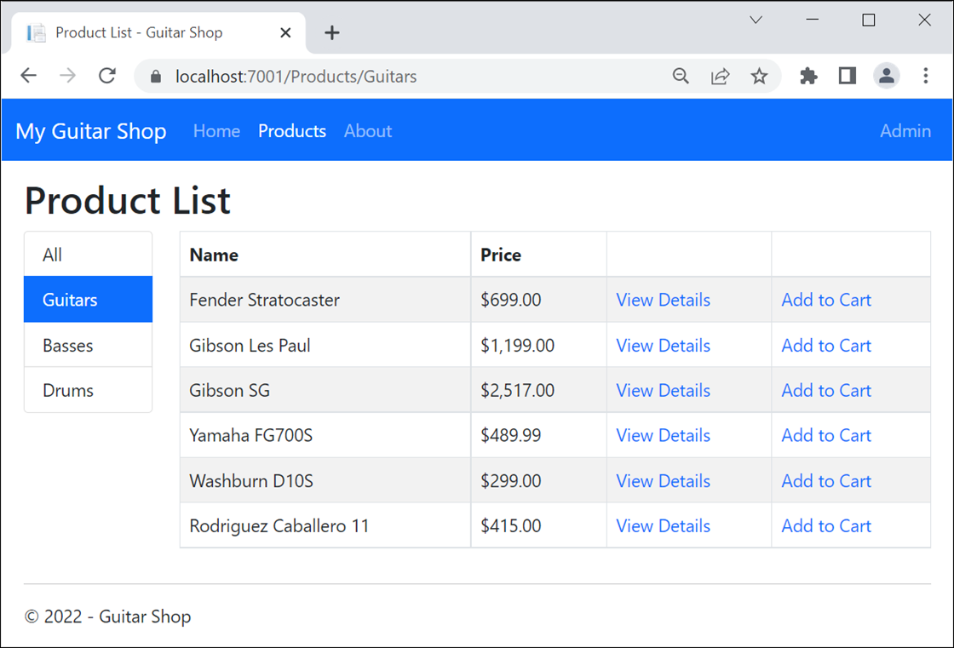
The Product List page for customers

Slide 77
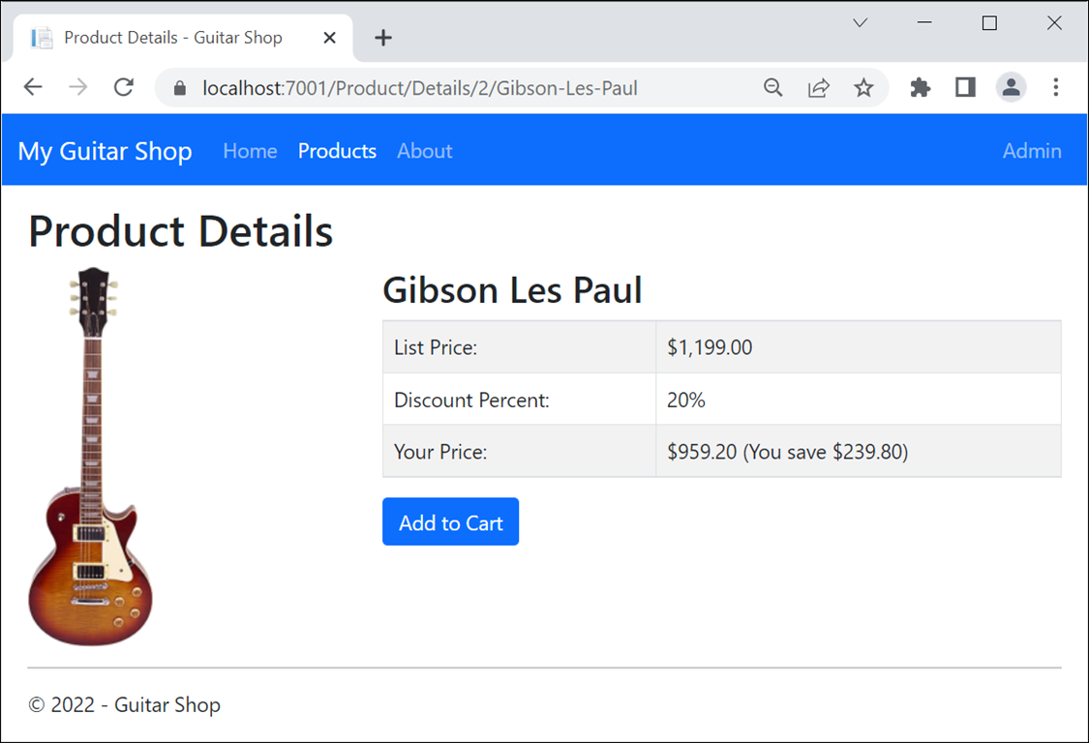
The Product Details page

Slide 78
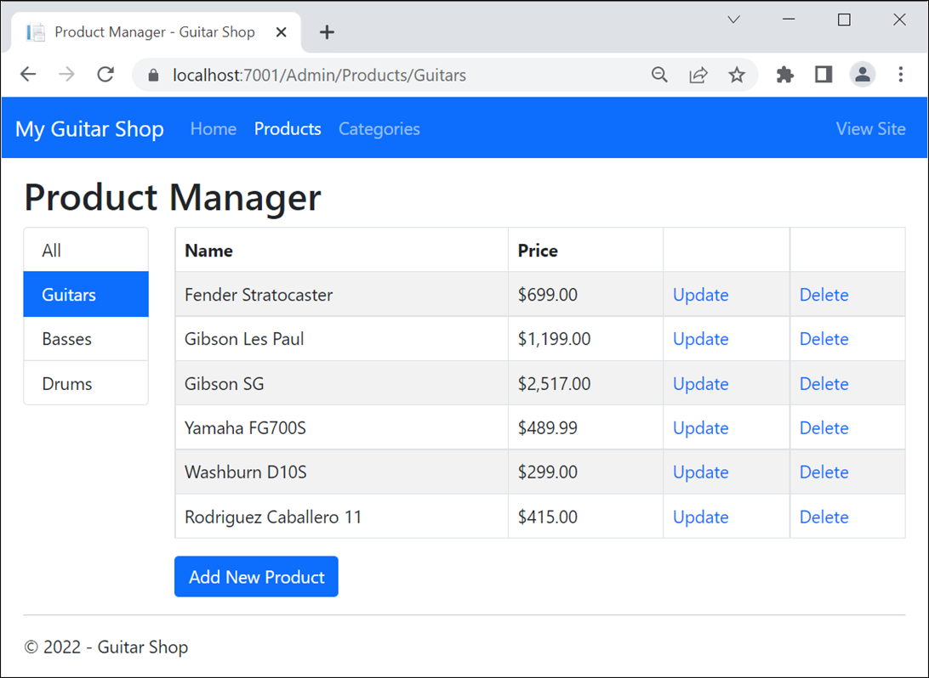
The Product Manager page for administrators

Slide 79
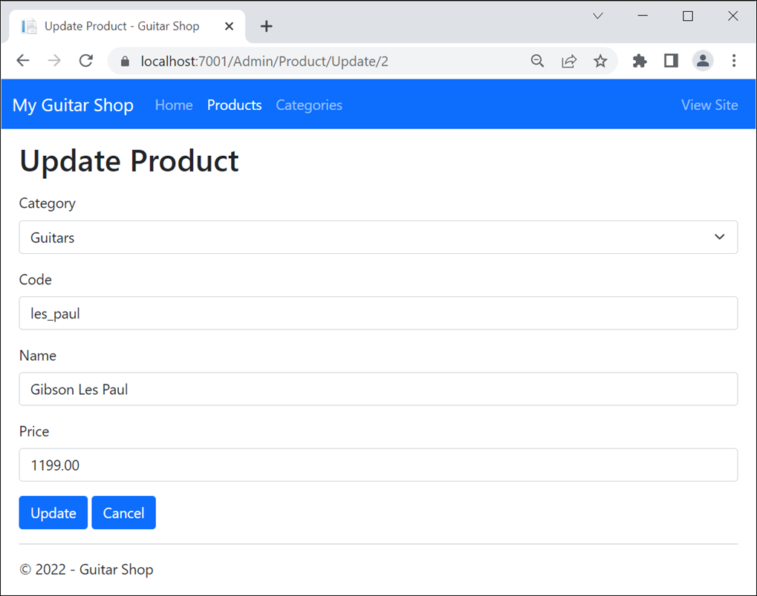
The Update Product page

Slide 80
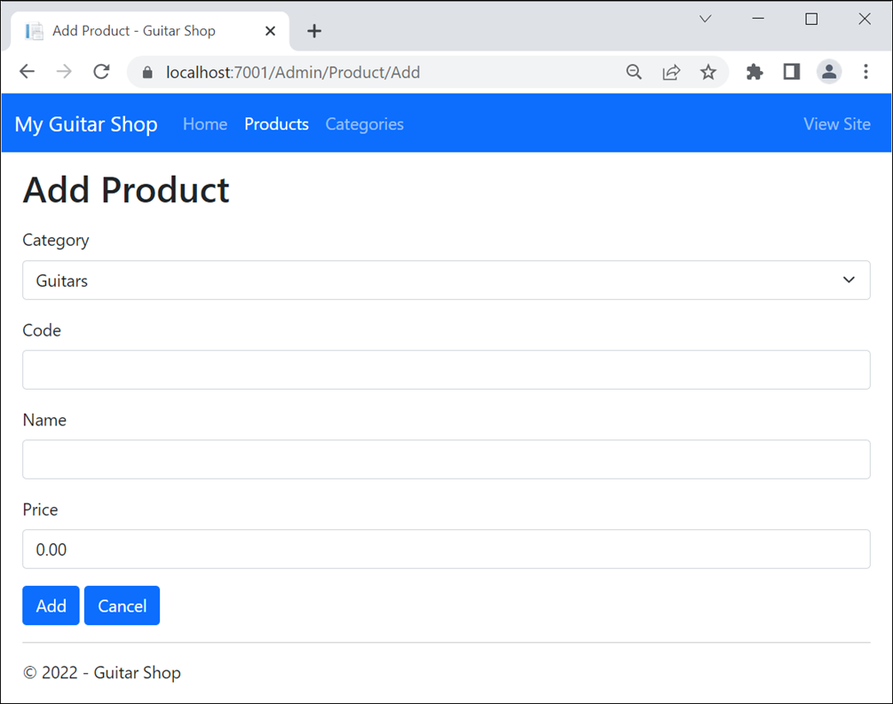
The Add Product page

Slide 81
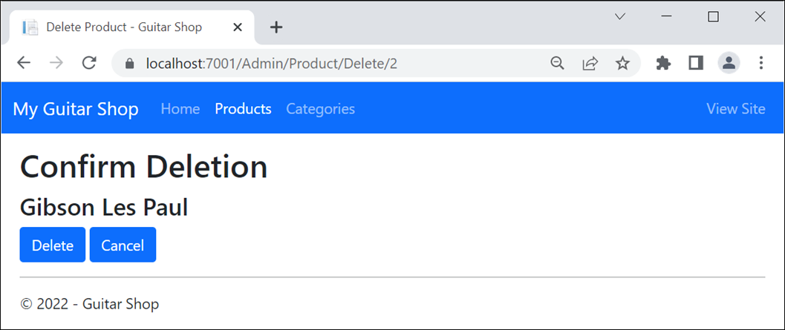
The Delete Product page

